Slide 1

-Address
-Phone Number
Home
Gift Cards
Services
Career
Contact
Book now
Join our team
Gift cards
services

Slide 2
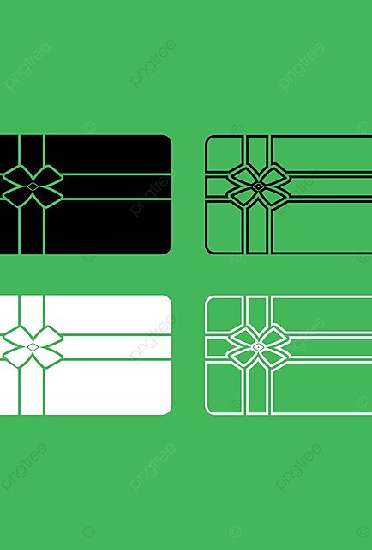
Home GiftCards Services Career Contact Purchase a gift cards for your loved ones
Gift cards available to purchase at our Salon
Feel free to contact us for any questions you may have
giftcard

Slide 3
Services Home Gift cards Services Career Contact
Look and feel amazing at our salon whether if it is just a haircut or color.
Haircut | $40
All Over Color | $80
Full Foil | $150
Partial Foil | $100
Color Correction | Price at Consultation

Slide 4
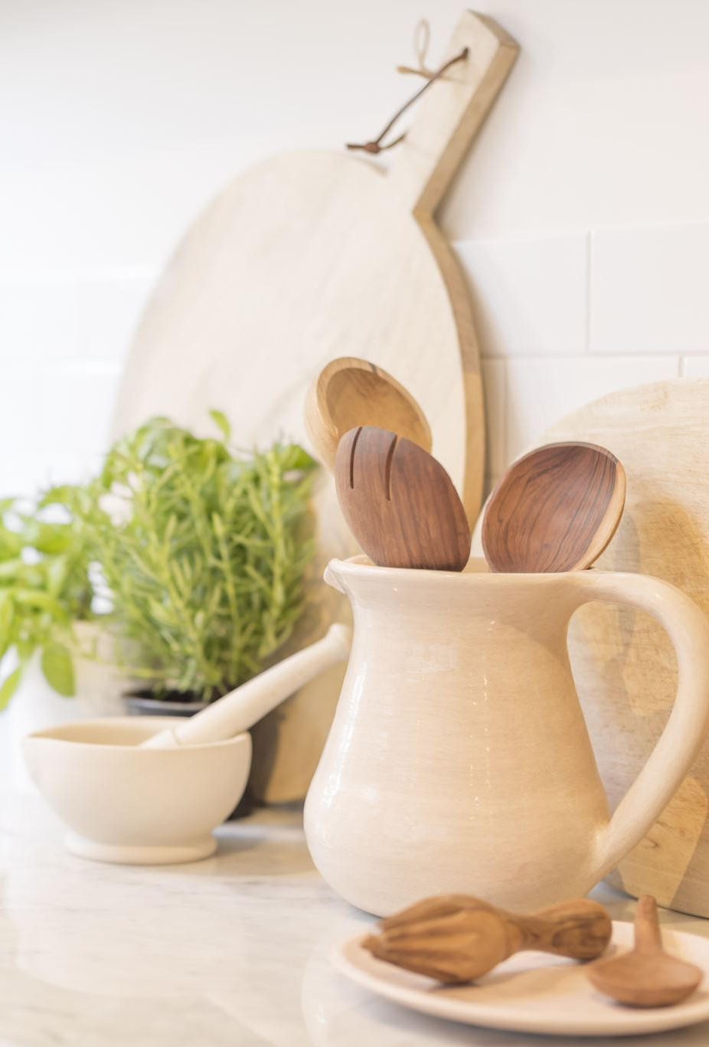
Career Home About Services Career Contact
I am Jill, a hairstylist and licensed cosmetologist from Arizona. Ever since my first trip to a hair salon when I was little, I cannot forget the feeling of confident and empowerment that it gave me after I got my hair done for the first time. I want to use my passion for hair to make everyone feel the same way I did when I was a kid. If you want to grow further in your hair journey and love to have fun and let your creativity run wild, then you’d fit perfectly here. Contact me at 123-456-7890 for more information.

Slide 5
Contact Home About Services Career Contact
Leave your name, number, and email! We will get back to you as soon as possible
Name:
Phone Number:
Email:
Message:

